Slide 1

Legal Aid: What’s Next?
Mark Benton, KC
2023 International Forum on Legal Aid
Taipei, Taiwan
November 2023

Slide 2




Acknowledgments and Appreciations
Prof. Dame Hazel Genn, DBE, KC (Hon), FBA
Peter van den Biggelaar
Prof. Alan Patterson, OBE FRSE, FRCP Edin, FRSA, FAcSS
Roger Smith OBE
Notes:
Hazel Genn – Paths to Justice research changed the conversation on access to justice – “Access to justice is the machinery that drives the Rule of Law”
Peter van den Biggelar – past CEO Netherlands legal aid- Conceived Rechtswijzer- the first biggest and best of the guided pathways to justice. Founding member of the ILAG and an ongoing contributor to development of legal aid internationally
Roger Smith- Lifetime legal aid and human rights advocate, Champion of the Legal Aid Group in England and Wales, leading international commentator on digital access to justice and legal aid.
Alan Patterson- founding member and chair of the ILAG, contributor to the development of legal aid intentionally and in his home country Scotland. A champion of sharing experiences and research to make legal aid better

Slide 3
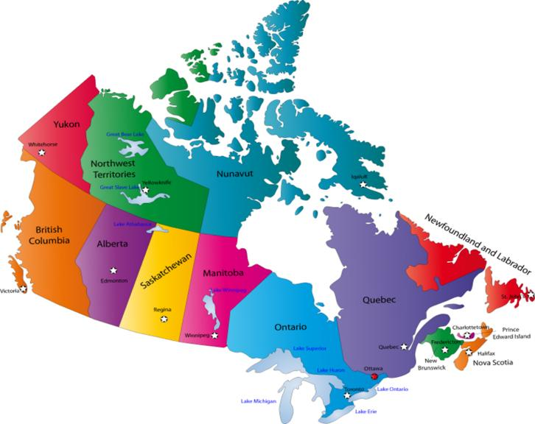
Governance and Service models
Financing
Governance
Eligibility
Delivery models
Service coverage

Slide 4

People with legal problems want to get on with their lives; and they want problem-solving processes that are:
1. Easy to use,
2. Inexpensive,
3. Timely,
4. Authoritative,
5. Transparent,
6. Fair.
Notes:
This is information largely comes from Hazel Genn’s summary analysis of what the world’s legal problems surveys tell us.
To find solutions, access to justice needs to be understood from the perspective of the people who experience legal problems. Problems cross the broad spectrum of everyday life. World wild national surveys show highly consistent results. And allow us to talk meaningfully about tailoring justice services to meet peoples needs and expectations. Solving legal problems so that people can get on with their lives is what justice effectiveness means to me. Note too that if you put the people using the system at the centre of this timeliness, cost, and simplicity become central values and measurable goals.
It is helpful to think for this as access to a broader range of services than just representation- information and advice are as central to engaging and resolving legal problems as representation is. Martyn Evans Report, Rethinking Legal Aid on Legal Aid in Scotland explores this well.

Slide 5
Three legal aid building blocks 1948-99
Procedural Justice
1960s SCOTUS - Gideon
Law societies, lawyers & judges lead
Social Justice / Civil Society
1960s - Dr. King
Empowerment
Politics and Social Policy
1947 - UK legal aid
Community clinics
Non-lawyers lead
Political but non-partisan
1974 - Canada Dept of Health
EU Human Rights frame
Government leads
Court centred

Slide 6

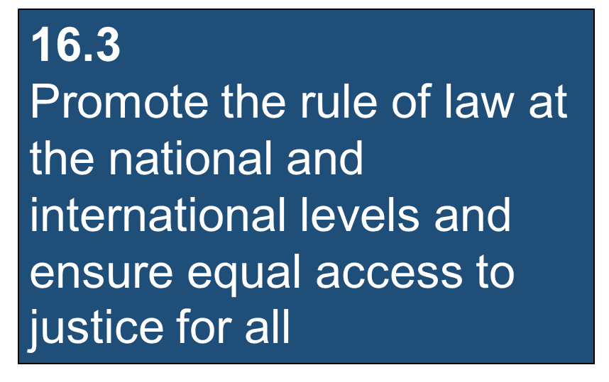
16.3.3 - Proportion of those who experienced a legal problem in the last two years who could access appropriate information or expert help and were able to resolve the problem
Notes:
The UN Sustainability Development Goals create new expectations for governments reporting on justice.
A better understanding of the importance of the Rule of Law means that there are important opportunities for legal aid programs and civil society agencies to partner with government and other public services in improving access to justice and the general well-being of the community.
A better understanding of how people experience legal problems allows for more targeted legal aid interventions designed to get more timely and lasting resolutions of legal problems while empowering people to shape the outcomes achieved.

Slide 7
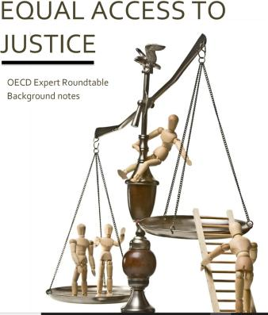
Equality Under the Law
+Transparency of Law
+Independent Judiciary
+Accessible Legal Remedy
= The Rule of Law
Notes:
The rule of law is the foundation for the development of peaceful, equitable and prosperous societies. There are four key areas that form the umbrella protection of the rule of law.
The increased to attention to access to justice as a key element to the Rule of Law and the ongoing research linking the Rule of Law to economic improvement are becoming incentives for more government engagement with legal aid and access to justice.
See the Lexis/Nexis Rule of Law Impact Tracker which quantifies the relationship between rule of law and social and economic development.

Slide 8

Three Big Rocks
For Legal Aid
Notes:
Steven Covey”s notion of three big rocks is a a metaphor for setting priorities and goals in life or work. The idea is to identify the three most important things that you want to achieve or focus on, and make sure that you allocate enough time and resources for them.

Slide 9

Big Rock #1
As competition for public funding increases it has become increasingly important for legal aid plans to be adept at demonstrating the public value of legal aid services.
Notes:
This requires a disciplined communication plan and consideration of services that both meet peoples legal needs and are seen to enhance public welfare / rule of law. E.G. Fiji Legal Aid Commission which serves an island nation and chooses expand there core services to include wills and coupling that with “road show” outreach services. This program continues and was directly linked to increased funding because of the Wills program’s popularity with the public.

Slide 10

Big Rock #2
Align with government, lawyers, the Judiciary, NGOs and health care providers to take a whole system approach to justice needs. This will require new collaborative and coordination skills to achieve client centered outcomes

Slide 11

Big Rock #3
With the trend towards more client-centred services and the persistence of tech change there will be increasing pressure on legal aid programs to incorporate more non-legal expertise in legal aid delivery and to have greater mastery of the tech environment to support the justice system and achieve better client outcomes.

Slide 12

Moving the rocks:
Technology as an enabler and an environmental risk

Slide 13
Four technology strategies to better meet legal aid clients’ needs:
1. Use tech to support cooperation and collaboration with other agencies to deliver to support early information, advice, referral and access to legal services.
2. The development of online tools to assist those people who can use them.
3. Online support to the delivery of legal services by lawyers, paralegals and others.
4.Innovating- finding new ways to use and advance the use of technology through research, experimentation and implementation
Notes:
Note re #1
Rich possibilities to improve access for difficult to reach client groups, opportunities to build relationships and networks across service delivery silos , e.g. mental health, justice, health care- guided pathways offer promise here
Note re #2
Law is complex however some people do have the social and technological skills to navigate the justice system if provided with some help – it’s the idea behind document assembly and guided pathways as legal aid tools. How large this group is will depend on who you are serving.- guided pathways and document assembly are proven tools.
Note re #3
This is particularly important with the emergence of AI powered search products
Note re #4
There is no one killer app for tech applications for legal aid. Everyone is pathfinding. We all can and we all should engage and contribute what we learn.

Slide 14
Bias in the algorithms?- almost certainly
Biases can be imbedded in any of the data, the design, and the use of the algorithms.
Data – for example facial recognition software where the data group is different than the subject group
Design – Where the algorithm does not produce accurate results
Use and interpretation-Where the user misunderstands or mistakenly interprets the results
Note that where rights and entitlements are involved potential bias becomes an important consideration. We need to presume bias in the algorithim based system to address it.

Slide 15

Who knew that I had to check that ChatGPT would not fabricate six cases that I used in my brief to the Court?
Lawyers need to be aware of the risks of AI assisted research
Notes:
Steven A. Schwartz, used ChatGPT to help him research for a personal injury lawsuit. ChatGPT is an AI tool that can generate text on various topics, but it is not reliable or accurate. Schwartz did not verify the information that ChatGPT provided him and included six fake cases in his court filing. These cases were exposed by the defendant’s lawyers and the judge, who ordered Schwartz and his colleague explain themselves and fined them.

Slide 16
Algogracy? Government by algorithm – or worse, program administration by algorithm
Australia's Robodebt
Netherlands child care benefit scandal
English Post Office Scandal
Notes:
Robodebt
Robodebt is the informal name given to a debt recovery program started in 2015 by the Australian government that falsely accused welfare recipients of owing money based on an incorrect algorithm¹. The program was ruled illegal by a court in 2019 and resulted in a $1.8 billion settlement for the affected people. The program caused significant harm and distress to many people, including some who took their own lives. A royal commission inquiry into the scandal issued its final report in March 2023, describing the scheme as a “costly failure of public administration” with “extensive, devastating, and continuing” ill-effects.
Dutch Childcare benefit scandal
The Dutch childcare benefits scandal is a political scandal in the Netherlands concerning false allegations of fraud made by the Tax and Customs Administration while attempting to regulate the distribution of childcare benefits. Between 2005 and 2019, authorities wrongly accused an estimated 26,000 parents of making fraudulent benefit claims, requiring them to pay back the allowances they had received in their entirety. In many cases, this sum amounted to tens of thousands of euros, driving families into severe financial hardship.
The scandal was brought to public attention in September 2018. Investigators have subsequently described the working procedure of the Tax and Customs Administration as "discriminatory" and filled with "institutional bias". On 15 January 2021, the government resigned over the scandal following a parliamentary inquiry into the matter, which concluded that "fundamental principles of the rule of law" had been violated.
English Post office scandal
The English Post Office scandal is a case of massive injustice that affected hundreds of sub-postmasters and sub-postmistresses who were wrongly accused of fraud, theft, and false accounting based on a faulty computer system called Horizon. The scandal spanned over two decades and resulted in many people losing their livelihoods, reputations, and freedom. Some even died by suicide or suffered from serious health problems due to the stress and trauma.
(A sub-postmaster is not an employee of the Post Office, but rather a self-employed contractor who receives a fixed annual fee and a commission based on the sales and transactions of the sub-post office. A sub-postmaster may also operate another business alongside the sub-post office, such as a convenience store or a newsagent.)
The Horizon system was introduced by the Post Office in 1999 and was developed by Fujitsu. It was used for various tasks such as transactions, accounting, and stocktaking. However, the system had many bugs and errors that caused discrepancies and shortfalls in the accounts of the sub-postmasters. Some of them tried to cover the losses with their own money, while others were pressured to confess or plead guilty to crimes they did not commit. The Post Office ignored their complaints and evidence of the system’s flaws and prosecuted them based on the data from Horizon¹.

Slide 17

England’s Post Office scandal
Notes:
Seema Misra was a sub-postmistress and was pregnant with her second child when she was convicted of theft and sent to jail in 2010. She said that she had been "suffering" for 15 years as a result of the saga. Described in press reports at the time as a “pregnant thief”, she went to prison and her husband was beaten up by locals. Her conviction was overturned in 2021.

Slide 18
Some opportunities
Guided Pathways
Document assembly
Generative AI: Chat GPT, and others
Cheaper, faster, better support to service providers

Slide 19

Notes:
Home – Rechtwijzer
Rechtwijzer is a website that provides legal information, advice, and self-help tools for people who have conflicts or disputes in various areas, such as divorce, consumer issues, government matters, housing, work, and debt. Rechtwijzer was developed by the Dutch Legal Aid Board and HiiL, a social enterprise that aims to improve access to justice. Rechtwijzer has two versions: 1.0 and 2.0.
Rechtwijzer 1.0 was launched in 2007 and was designed to help people diagnose their legal problems and get directed to a lawyer or juridical support. It was an online platform that offered guidance, referrals, and information on legal rights and procedures.
Rechtwijzer 2.0 was launched in 2014 and was designed to help people resolve their disputes online without going to court. It was an online platform that enabled parties in a conflict to interact, negotiate, mediate, and adjudicate on their issues. It also offered coaching and support from legal experts and professionals. Rechtwijzer 2.0 initially focused on divorce cases, but later expanded to other types of conflicts, such as landlord-tenant disputes and consumer complaints..
Rechtwijzer is considered one of the most innovative and successful examples of online dispute resolution (ODR) in the world.

Slide 20
Rechtwijzer and the guided pathways
2007-Dutch Legal Aid Board launches Rechtswijzer a guided pathways approach to client triage it was developed as a collaboration involving Netherlands Legal Aid, Netherland Ministry of Justice and Netherlands lawyers among others
2012- Bigger platform and international approach to be self funded
2014- Rechtwijzer 2.0 launches as a collaboration of the Dutch Legal Aid Board, the NGO HiiL, and Modria (now Tyler Technologies) to be self funded.
2014 and 15 – Legal Aid BC begins its work to tailor Rechtwijzer to meet a more modest client information target including the negotiation platform that launches as MyLawBC
2017- End of collaboration on Rechtwijzer 2.0 although the Dutch Legal Aid Board continues to operate a lighter version as part of its operations
2022 LegalAidBC discontinues the MyLawBC program. The ongoing cost was considered too high for the services delivered
Notes:
But LABC learned a great deal

Slide 21
What we learned from Rechtwijzer and MyLawBC
Tech applications require project discipline and dedicated resources
Collaborations are necessary but messy and hard to do well.
Some but not all the people in the legal aid client group have the digital skills and digital comfort to use online legal services.
Using tech to support service delivery builds capacity to both do more delivery and to understand legal aid delivery better – it changes your organization and
Many service delivery professionals are skeptical of the idea of tech based legal services but many end up using them to help them help their clients.
It changed the way I think about legal aid services.
Notes:
The question will most often be whether the investment of resources can be justified by improved effectiveness and/or efficiency.
And information specialists see guided pathways as a smart way to deliver complex online information
We learned:
That the online dispute resolution and addressing legal problems online is not for everyone. It requires both digital skills and some comfort and trust in the online environment – lots researched the site and started a pathway but not vary many actually completed it.
More research is needed about designing legal pathways that meet peoples needs
Legal aid plans are reticent to “dive in” to tech based solutions

Slide 22
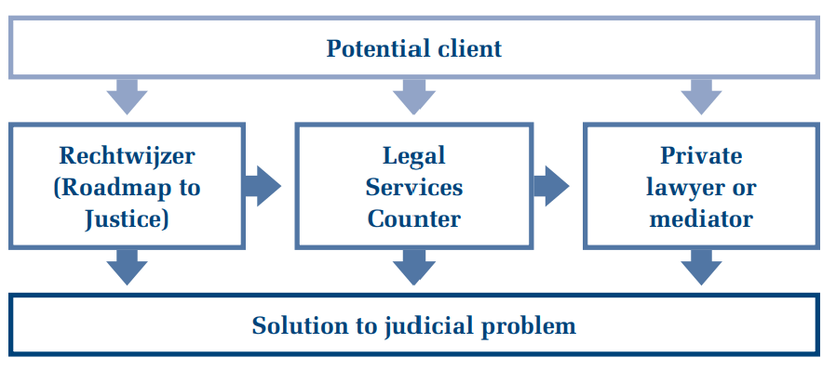
Dutch Legal Aid Board Services Schematic
Notes:
In the current delivery model guided pathways are integrated into the Netherlands Legal Aid services. It points to the importance of integration to support sustainability of online services

Slide 23
Document assembly
Rechtwijzer
LawHelp Interactive: An online platform that provides free legal document assembly services for low-income people and pro bono lawyers in the United States. It uses HotDocs and A2J Author software to create interactive interviews that guide users through the process of generating legal documents.
New York State Courts Access to Justice Program: A program that develops and implements online document assembly projects for court users who do not have a lawyer. It uses A2J Author software to create user-friendly web-based applications that produce court documents for various matters.
Notes:
Document assembly software is a type of software that allows users to create customized documents from templates and data. It can automate the process of filling in forms, contracts, letters, and other types of documents by using logic, variables, and conditional statements. Document assembly software can save time, reduce errors, and improve consistency in document creation.
.
Document assembly software can help people who have legal problems or needs but cannot afford or find a lawyer. Document assembly software can provide self-help tools that enable people to understand their legal situation, prepare their own documents, and represent themselves in court or other forums. Document assembly software can also assist lawyers and legal aid organizations who serve low-income or marginalized communities by increasing their efficiency and productivity.

Slide 24
Generative AI and support to service providers- too soon to tell
Tech will change the environment we work in and the supports necessary to do legal aid work well.
Problem analysis, issue identification and possible resolutioins will all be affected.
Legal aid Plans will need to ensure that their services providers are properly supported. Looking to how governments are supporting their own legal work and how other legal aid plans are addressing the issues will be important .
Look to collaborate and cooperate to spread risk and explore whole system solutions. It is important to engage rather than ignore the changes happening around us.

Slide 25
Important collateral issues: Data, Design , Interpretation, Digital Skills
Make sure your data is robust.- it will help you to plan, to identify opportunities and convince others of the need for change
Treat tech changes as both a threat and an opportunity in your strategy development
Engage with tech to understand its implications. Its too important to leave to your tech specialists.
Have a look at the sites I have referred to and watch for legal aid tech developments in Europe, the UK, Australia, and in the USA.
Be cautious about the hype- it’s a feature of tech change that is a risk.

Slide 26

Technology is not a magic bullet but it may be a silver one !
Assess, experiment, implement !
Notes:
Roger Smith
Limited resources
Economy of scale

Slide 27
People with legal problems want to get on with their lives;
and, they want problem-solving processes that are:
  Easy to use, Cheap, Timely
  Authoritative, Transparent, Fair
Notes:
Remember that its all about the services that meet client need, not about the tech

Slide 28

The end

